Slide 1
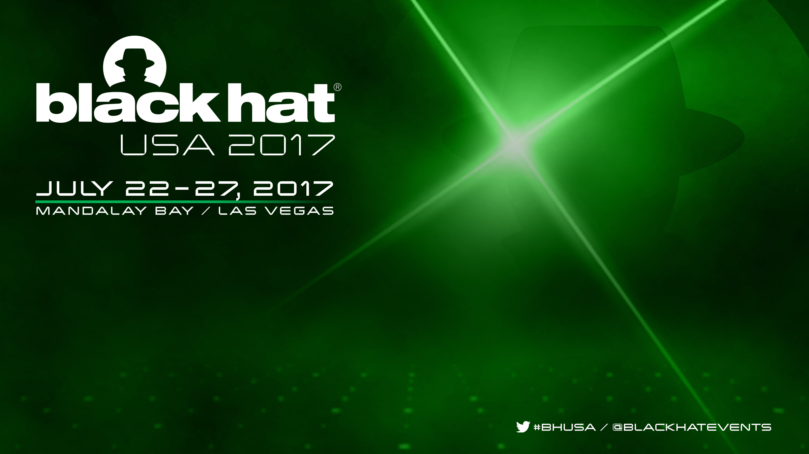
Firmware is the new Black – Analyzing Past 3 years of BIOS/UEFI Security Vulnerabilities
Bruce Monroe & Rodrigo Rubira Branco (@bsdaemon) & Vincent Zimmer (@vincentzimmer)
{ bruce.monroe || rodrigo.branco || vincent.zimmer } @ intel.com

Slide 2
ABSTRACT
In recent years we witnessed the rise of firmware-related vulnerabilities, likely a direct result of increasing adoption of exploit mitigations in major/widespread operating systems, including for mobile phones. Pairing that with the recent (and not so recent) leaks of government offensive capabilities abusing supply chains and using physical possession to persist on compromised systems, it is clear that firmware is the new black in security. This research looks into BIOS/UEFI platform firmware, trying to help making sense of the threat. We present a threat model, discuss new mitigations that could have prevented the issues and offer a categorization of bug classes that hopefully will help focusing investments in protecting systems (and finding new vulnerabilities). Our data set comprises of 90+ security vulnerabilities handled by Intel Product Security Incident Response Team (PSIRT) in the past 3 years and the analysis was manually performed, using white-box and counting with feedback from various BIOS developers within the company (and security researchers externally that reported some of the issues - most of the issues were found by internal teams, but PSIRT is involved since they were found to also affect released products).
Notes:
This is our abstract Bruce

Slide 3

DISCLAIMER
Intel has official documentation that is highly comprehensive and should be used to make technical decisions related
to Intel’s technologies. To have a high-level of accuracy for such documentation, lots of reviews are performed
The accuracy of this talk can’t be compared and should not be used to compare with official documentation. We
are going to discuss directions, strategies and initiatives being proposed, giving recommendations to OEMs, researchers
and customers but everything should be treated as *OUR* opinion instead of official statements
There possibly are other initiatives and focus areas that we are not at liberty to talk about or that we are even unaware
of, so this should not be considered the full scope of the problem, but instead, *OUR* vision of it
This talk is about BIOS/UEFI security. We are not pedantic on terminology (since we accept that the majority outside
of Intel have a harder time to know/differentiate what is the responsibility of different components of the platform in
order to guarantee the security of it). As so, we did include things that are *NOT* directly related to errors in BIOS/UEFI
per-se, but that somehow affected the expectations for it
Notes:
The last line of the disclaimer was added because in the classes I’ve added cache overwriting SMM area, fuses not properly setup and priority decoding for overlapping ranges (the LAPIC bug), which are outside of the expectation for BIOS/UEFI itself, but did affect BIOS/UEFI security.
Bruce

Slide 4
Agenda
BIOS/UEFI background
BIOS/UEFI ecosystem
BIOS/UEFI security technologies
Dataset & Methodology
Bug classes (a proposal for UEFI)
Vulnerability distribution (by bug classes)
Platform Firmware Threat Modelling
Future
Notes:
Bruce

Slide 5
UEFI Background
UEFI – Unified Extensible Firmware Interface old school terms…(BIOS)
First up root of trust on the system
It hands over control to the operating system
Rest of the magic then occurs ;)
UEFI Membership spans the compute spectrum
http://uefi.org/members
UEFI – sets up the platform to run…
Notes:
Bruce

Slide 6
Where is UEFI firmware
VM
VM
App
App
App
App
OS
OS
BIOS & OS/VMM share access, but not trust
UEFI + PI SMM
VMM / Hypervisor
SMM / BIOS
Privilege
Hypervisor can grant VM direct hardware access
CPU
Memory
Peripherals
Firmware
Hardware
A specific Peripheral may have its own processor, and its own firmware, which is undetectable by host CPU/OS.
Platform
DMA
Notes:
Bruce

Slide 7
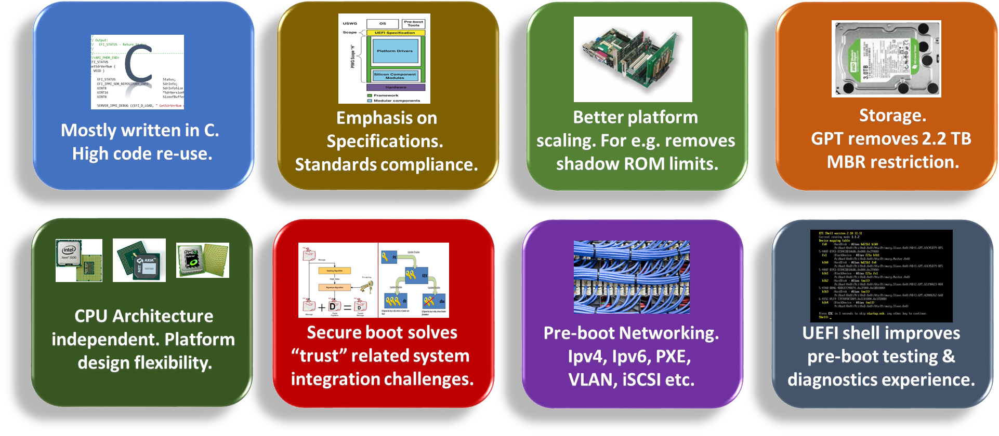
What’s in UEFI
Notes:
Bruce

Slide 8
UEFI Ecosystem Overview
UEFI Ecosystem is an “Onion”. Layers upon layers…
Peel the onion and you have:
Tianocore (Open Source EDK II) Intel is the sole maintainer
IBV – Independent BIOS Vendors
OEM – Other Equipment Manufacturers (The folks building your systems)
ODM – Original Design Manufacturer
Consumers (deliberate action to download/install updates)
If a vuln mitigation goes out it has to navigate the onion
Additional update lag time is introduced because end users have to take deliberate action to download/install updates
Notes:
Bruce

Slide 9
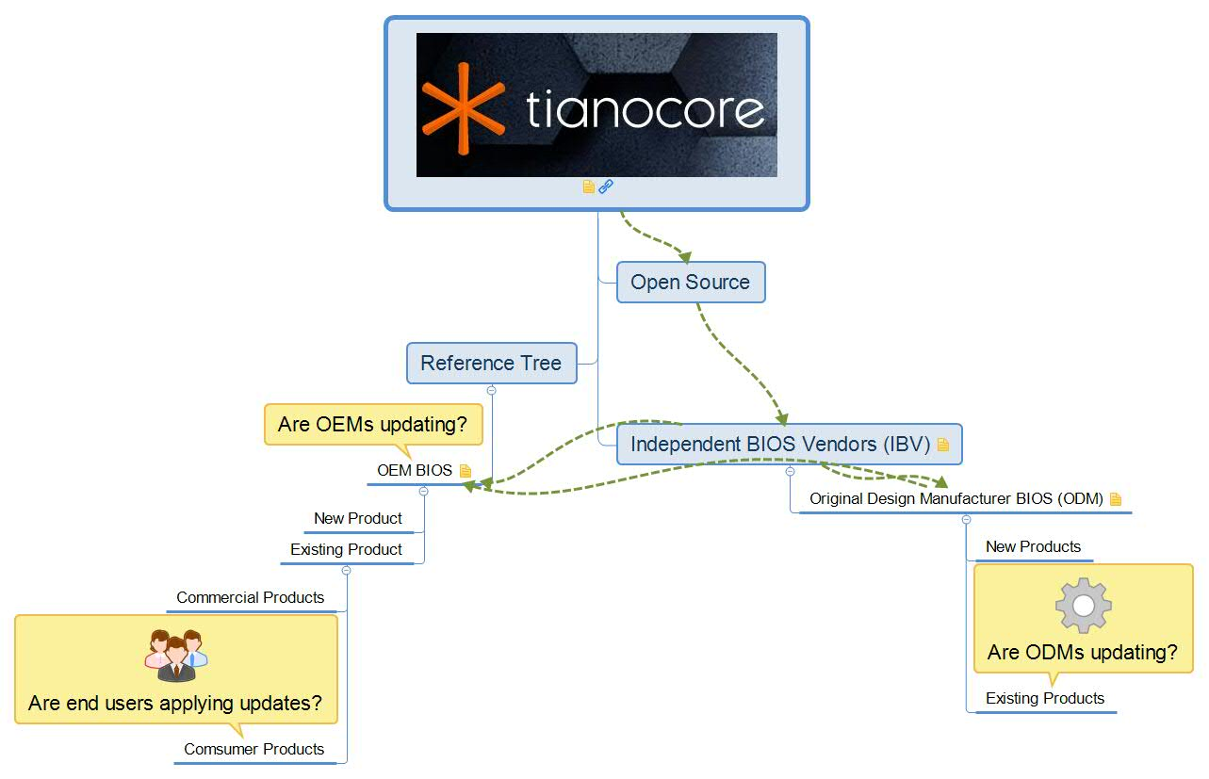
UEFI Ecosystem
Notes:
Bruce

Slide 10
History
UEFI.org is a standards body
UEFI is a specification
About 2 years ago UEFI.org stood up USRT
USRT – is Unified Security Response Team
Sea change. UEFI had never taken a stance on implementations.
They Are Now…
Notes:
Bruce

Slide 11
UEFI USRT
USRT is comprised by Firmware Engineers from member companies
To report a security issue in UEFI Firmware implementation from a vendor:
Send email to security@uefi.org
Encrypt sensitive info with their PGP public key - security@uefi.org
Please provide as much information as possible, including:
The products and versions affected
Detailed description of the vulnerability
Steps to demonstrate the vulnerability or reproduce the exploit, including specific configurations or peripherals, if relevant
Potential impact of the vulnerability, when exploited
Information on known exploits
Notes:
Bruce

Slide 12
Reporting to Intel Bug Bounty
Tianocore EDK II that is solely maintained by Intel is in bug bounty scope
Send vulnerability report to secure@intel.com
Encrypt using PGP Public Key of secure@intel.com
Intel Bug Bounty Program is Private Invite Only
If you find a good quality bug in Tianocore we will extend an invite providing you agree to abide by Intel Bug Bounty program terms
Note: you need to be invited to be eligible
You can find more information on the Intel Bug bounty program online
Full participation guidelines https://security-center.intel.com/docs/BugBountyParticipationGuidelines.pdf
Notes:
Bruce

Slide 13
Intel Bug Bounty Recap
The Intel Bug Bounty Program is a Private Invite Only program
If the security vulnerability is in open source implementation of Tianocore solely maintained by Intel
It’s Eligible for the Intel Bug Bounty Program administered by HackerOne
You must be invited to join via HackerOne platform
Vulnerability Severity | Intel Software | Intel Firmware | Intel Hardware
Critical | Up to $7,500 | Up to $10,000 | Up to $30,000
High | Up to $2,500 | Up to $5,000 | Up to $10,000
Medium | Up to $1,000 | Up to $1,500 | Up to $2,000
Low | Up to $500 | Up to $500 | Up to $1,000
Notes:
Bruce

Slide 14
EDKII Bugzilla
The EFI Developer Kit II (EDKII) provides an open source implementation http://www.tianocore.org/
Core features https://github.com/tianocore/edk2
Platform examples https://github.com/tianocore/edk2-platforms
Reporting security issues on open source https://github.com/tianocore/tianocore.github.io/wiki/Reporting-Security-Issues
Advisories https://www.gitbook.com/book/edk2-docs/security-advisory/details
Notes:
Bruce -> Vincent transition

Slide 15
Use of EDKII Defenses
UEFI is the specification
EDK II is the code
System
Protect
Firmware
Detect
Recover
Notes:
Vincent

Slide 16
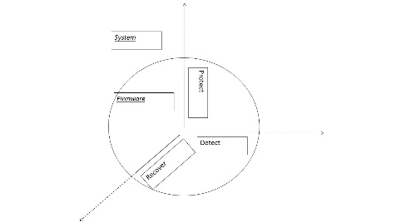
Fully Verified Boot Sequence
Protect
Detect
CPU/SOC
(Intel)
Start Block PEI
(OEM)
BIOS DXE/UEFI
(OEM)
OS Loader/Kernel
(OSV)
Measure
Measure
Measure
Intel® Boot Guard
Executable
Executable
Executable
Enforces
Enforces
Enforces
Policy Engine
Policy Engine
Policy Engine
Policy
Policy
Policy
Intel® Device Protection Technology with Boot Guard
http://www.intel.com/content/dam/www/public/us/en/documents/product-briefs/4th-gen-core-family-mobile-brief.pdf
OEM PI Verification
Using PI Signed
Firmware Volumes Vol 3, section 3.2.1.1
of PI 1.3 Specification
OEM UEFI 2.7 Secure Boot
Chapter 27.2 of
The UEFI 2.4 Specification
Notes:
Vincent

Slide 17
Trusted Versus Secure Boot
Protect
Detect
UEFI PI will measure OS loader & UEFI drivers into TPM (1.2 or 2.0) PCR (Platform Configuration Register)
UEFI authenticate OS loader (pub key and policy)
UEFI Firmware
UEFI
UEFI OS Ldr, Drivers
Check signature of before loading
Kernel
record in PCR
TPM
Drivers
UEFI Secure boot will stop platform boot if signature not valid (OEM to provide remediation capability)
UEFI will require remediation mechanisms if boot fails
Apps
TCG Trusted boot will never fail
Incumbent upon other software to make security decision using attestation
Notes:
Vincent

Slide 18
EDKII Defenses (1/3)
Protect
Detect
Recover
UEFI Secure and TCG Measured boot - Upper layer API’s defined in UEFI and TCG spec
Implementation source + document for UEFI Secure & TPM measured boot
https://github.com/tianocore/edk2/tree/master/SecurityPkg
https://firmware.intel.com/sites/default/files/resources/A_Tour_Beyond_BIOS_Implementing_TPM2_Support_in_EDKII.pdf
http://bluestop.org/edk2/docs/specs/A_Tour_Beyond_BIOS_into_UEFI_Secure_Boot_White_Paper.pdf
Signed updates - Capsules defined in UEFI Spec
Signed updates required by NIST 800-147 http://csrc.nist.gov/publications/nistpubs/800-147/NIST-SP800-147-April2011.pdf for core and NIST-193 http://csrc.nist.gov/publications/drafts/800-193/sp800-193-draft.pdf for platform components
https://github.com/tianocore/edk2/tree/master/SignedCapsulePkg
https://github.com/tianocore-docs/Docs/raw/master/White_Papers/A_Tour_Beyond_BIOS_Capsule_Update_and_Recovery_in_EDK_II.pdf
Notes:
Vincent

Slide 19
EDKII Defenses (2/3)
Protect
Recover
Defense in depth mechanisms of UEFI Core
NX, ASLR, stack canaries during pre-OS https://www.gitbook.com/book/edk2-docs/a-tour-beyond-bios-memory-protection-in-uefi-bios/details
Hardened SMM
Implementing the Windows SMM Mitigation Table (WSMT) https://github.com/tianocore-docs/Docs/raw/master/White_Papers/A_Tour_Beyond_BIOS_Secure_SMM_Communication.pdf
A_Tour_Beyond_BIOS_Securiy_Enhancement_to_Mitigate_Buffer_Overflow_in_UEFI https://github.com/tianocore-docs/Docs/raw/master/White_Papers/A_Tour_Beyond_BIOS_Securiy_Enhancement_to_Mitigate_Buffer_Overflow_in_UEFI.pdf
And lock-box protocol, user identification, password, and random number generation
Overall dev BKM (Best Known Methods)
Security BKM https://github.com/tianocore-docs/Docs/raw/master/White_Papers/A_Tour_Beyond_BIOS_Security_Design_Guide_in_EDK_II.pdf
Notes:
Vincent

Slide 20
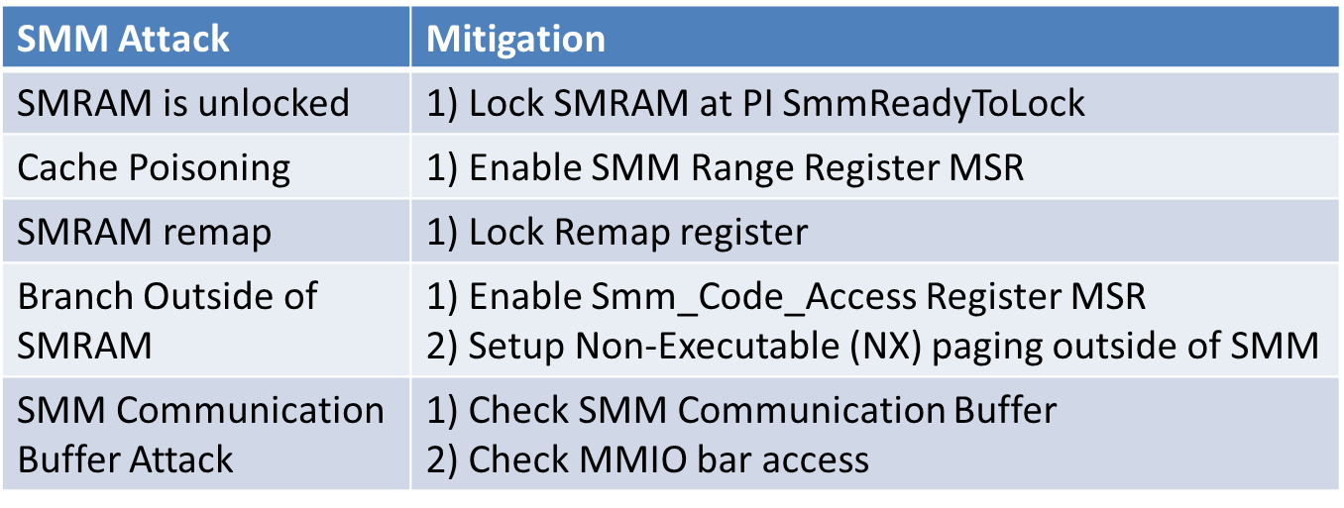
Continued SMM Defenses
Protect
Intel STM (SMI Transfer Monitor): https://firmware.intel.com/content/smi-transfer-monitor-stm
BIOS Guard (PFAT): SMM compromises do not directly lead to flash access (persistence)
Other SMM protections:
Notes:
Vincent

Slide 21
EDKII Defenses (3/3)
Protect
Detect
Recover
VT-d boot protection
https://lists.01.org/pipermail/edk2-devel/2017-April/009454.html https://firmware.intel.com/sites/default/files/resources/A_Tour_Beyond_BIOS_Using_Intel_VT-d_for_DMA_Protection.pdf
And to pull things together - Full open source EDKII-based platforms
Quark https://github.com/tianocore/edk2/tree/master/QuarkPlatformPkg
Atom BYT https://github.com/tianocore/edk2-platforms/tree/minnowboard-max-udk2015
Atom APL https://github.com/tianocore/edk2-platforms/tree/devel-MinnowBoard3-UDK2017
Intel KBL https://github.com/tianocore/edk2-platforms/tree/devel-MinPlatform core platform tree
Atom and core platforms based upon Intel Firmware Support Package (FSP)
https://github.com/IntelFsp/FSP
https://firmware.intel.com/sites/default/files/A_Tour_Beyond_BIOS_Using_the_Intel_Firmware_Support_Package_with_the_EFI_Developer_Kit_II_%28FSP2.0%29.pdf
http://www.apress.com/us/book/9781484200711
Very through training package made available by Intel’s ATR* – covers chipsec
https://github.com/advanced-threat-research/firmware-security-training
Intel’s ATR moved from SeCoE to Intel Security and is now part of McAfee
Notes:
Vincent

Slide 22
Dataset & Methodology (1/2)
It is quite hard to provide really good analysis of datasets related to security issues:
A must see if somehow you wonder why: https://media.blackhat.com/us-13/US-13-Martin-Buying-Into-The-Bias-Why-Vulnerability-Statistics-Suck-Slides.pdf
We used Intel’s PSIRT Data in different ways:
For the past 3 years (124 issues related to BIOS/Firmware), to give an ‘idea’ of the amount of issues (which adds attrition bias as well)
For as long as we could find (Circa 2007), to generate taxonomy
Intel’s PSIRT data include issues found internally (vendor selection bias) that somehow were identified to affect released products
It does not mean every internally found issue is there
The way the data is capture changed along the years (hopefully for better), but that is one of the mistakes clearly stated in the aforementioned presentation ☺
We constantly receive reports for issues that affect a specific OEM-only (and as so, have nothing to do with Intel – please, keep involving us, it is helpful!): We counted those too, but obviously, lots of issues are not reported to us as well (that also adds a researcher selection bias, since some researchers always involve us and as so, whatever issues they are finding, are accounted for, but not all researchers do that)
PSIRT does sometimes group multiple issues under one case (specially internal ones), and as so, the count itself also added an abstraction bias
For some other cases, issues are divided in multiple cases (given it potentially spawning multiple different actions): We tried to clean the obvious cases
We only considered the confirmed issues that affect at least one product, therefore there is also publication bias
Total number of issues considered/used: 77 issues
Notes:
Vincent -> Rodrigo transition

Slide 23
Dataset & Methodology (2/2)
With so many problems in the dataset, does it have any value?
Yes, but not to compare platforms (so we do not include such information)
Yes, for defining a taxonomy (so we did generate/propose one)
Yes, to help defining next steps/future strategies (so we did do that)
Maybe, to define trends (as in: are those kind of problems getting more external attraction?)
No, if you want to say that there are more bugs (not bugs being reported, which is the previous point) now than few years back -> DO NOT USE THE DATA FOR THAT PURPOSE ☺
Notes:
Rodrigo

Slide 24
HW Bugs?
Those bugs are not BIOS-bugs per-se, but they do affect platform security and what is expected from BIOS (we did not consider them in the total count presented, and we did group those in the taxonomy as a single class: ‘HW bugs’). Some examples:
LAPIC bug (memory range overlapping and decoding priorities leading to SMRAM access)
SMM memory written-back cached data from Ring0 leading to SMRAM access
Fuse mis-configuration for BootGuard leading to platform compromise (See for example “Safeguarding rootkits: Intel BootGuard” presented at ZeroNights 2016 (https://dsec.ru/upload/medialibrary/82b/82b222a0ab6470a724108b42208f0630.pdf)
Notes:
Rodrigo

Slide 25
Proposal of Bug Classes (1/2)
We do not claim it to be a comprehensive list, but it is comprehensive enough to cover all PSIRTs received by Intel
Many bugs might fit multiple classes (since one problem might lead to another, we use the first in the chain to aggregate)
Help evolve this list
Notice that we grouped together things that are a bit more classical software cases (for example, not properly validating untrusted input)
But we still called out ones that have some specificities due to the expectations for the whole platform security
The main intention: be able to easily define a class for a given issue and to remove the sentiment (shared by many researchers) that BIOS security is something obscure
Notice that when we group the classes per the number of reported issues in each ☺
The main complexity is the sheer number of platform-specific configurations
Notes:
Rodrigo

Slide 26
Proposal of Bug Classes (2/2)
Inconsistent power-transition checks
Bad Initialization State (secrets kept in memory, assumption of certain system state)
S3 Boot Script
Race Condition
Enabling protection mechanisms (including disabling/enabling certain HW elements, including wrong module launching order)
Time of Check/Time of Use (TOCTOU) Race Conditions
Trusting input (from less privileged entities in the platform, or having different assets configured by different threat vectors)
Could lead to race conditions (double fetches and TOCTOUs, for example if a pointer is pointing to unprotected memory area and therefore can be arbitrarily modified after any checks)
Measurement failures
Not measuring certain modules
Accepting signed updates, but for the wrong platform due to using same keys
Accepting to load certain modules in the wrong time (when certain assets are not properly protected)
Failing to identify a measurement error/problem
Platform capability not properly configured
Locks not set, devices not properly initialized, features not disabled, etc
Security of meaningful assets exposed to untrusted entities
E.g.: UEFI variables
HW Misbehavior
Wrongly defined architecture, micro-architecture, bad design, etc
Platform components behaving differently than specified
Notes:
Rodrigo

Slide 27
Examples (1/7)
Inconsistent power-transition checks
Bad Initialization State (secrets kept in memory, assumption of certain system state)
S3 Boot Script
Many talks mention the S3 Boot Script vulnerability and public exploits/write-ups are available (http://blog.cr4.sh/2015/02/exploiting-uefi-boot-script-table.html)
Some of the bugs in this category can be very subtle, like when a system is turned on a given code path is taken which copies certain data structures inside SMRAM for parsing, while when the system is coming back from resume the SMM code consumes external tables directly (therefore, wrongly trusting the runtime OS)
Notes:
Rodrigo

Slide 28
Examples (2/7)
Race Condition
Enabling protection mechanisms (including disabling/enabling certain HW elements, including wrong module launching order)
Time of Check / Time of Use TOCTOU Race Condition
A good example we saw was a third party option ROM being launched before EndOfDxe (lots of assets unprotected)
Another common case is SMM code validating input *before* copying it to protected memory (which could be altered after the checks)
We experimenting with extending Simics to catch some of those (See: “Windows Kernel Race Condition Analysis While Accessing User-mode Data” paper in PoC || GTFO for some of our tests/experiments reproducing Project Zero’s work on Windows for similar problem) https://www.alchemistowl.org/pocorgtfo/pocorgtfo15.pdf
Notes:
Rodrigo

Slide 29
Examples (3/7)
Trusting input (from less privileged entities in the platform, or having different assets configured by different threat vectors)
Could lead to race conditions (double fetches and TOCTOUs, for example if a pointer is pointing to unprotected memory area and therefore can be arbitrarily modified after any checks)
Traditional code bugs apply here (like buffer and integer overflows)
Lots presented/found along the years by Intel’s ATR, SeCoE and other internal and external researchers
Many caught by our Excite Project (BIOS symbolic execution) (https://github.com/REhints/Publications/blob/master/Conferences/ZeroNights_2016/Excite_Project_ZN.pdf)
Notes:
Rodrigo

Slide 30
Examples (4/7)
Measurement failures
Not measuring certain modules
Accepting signed updates, but for the wrong platform due to using same keys
Accepting to load certain modules in the wrong time (when certain assets are not properly protected)
Failing to identify a measurement error/problem
Two real examples we’ve seem:
Client & Server parts using the same keys, meaning that an image from one would load in the other, but obviously bricking the platform
TE (Terse Executables) are loaded correctly, but not measured since deeper parts check for specific PE header presence (but the boot succeeds)
Notes:
Rodrigo

Slide 31
Examples (5/7)
Platform capability not properly configured
Locks not set, devices not properly initialized, features not disabled, etc
Lots of times guidance is just not being followed
Chipsec use by OEMs and consumers would identify most of these
See the Chipsec Platform Security Assessment Framework
https://github.com/chipsec/chipsec
Watch the talk in H2HC: “Betraying the BIOS: Where the guardians of the BIOS are failing” for real life recent examples ☺. Callout to Alex Matrosov
Notes:
Rodrigo

Slide 32
Examples (6/7)
Security of meaningful assets exposed to untrusted entities
E.g.: UEFI variables
At least one case we’ve seem included UEFI variables that control PK/KEK not requiring physical presence to be modified
That essentially undermines Secure Boot
Some times, sample code has validation features that should be disabled/removed from production versions, such as a UEFI variable that sets the policy responsible for configuring EISS (also known as SMM_BWP, which essentially opens the flash for writes from outside of SMM) bit in the SPI controller to be false
Notes:
Rodrigo

Slide 33
Examples (7/7)
HW Misbehavior
Wrongly defined architecture, micro-architecture, bad design, etc
Platform components behaving differently than specified
See Intel’s Erratas ☹ We do our best, but things fail. Complexity and composition are security’s worst enemies
Examples of those:
The Memory Sinkhole (by Christopher Domas in Black Hat USA 2015) https://www.blackhat.com/docs/us-15/materials/us-15-Domas-The-Memory-Sinkhole-Unleashing-An-x86-Design-Flaw-Allowing-Universal-Privilege-Escalation-wp.pdf
Phrack article “Using SMM for Other Purposes” (http://phrack.org/issues/65/7.html) release of a weird cache behavior, followed by Joanna’s and Rafal’s work proving it was an exploitable vulnerability in “Attacking SMM Memory via Intel CPU Cache Poisoning” (http://invisiblethingslab.com/resources/misc09/smm_cache_fun.pdf)
McAfee ATR work on “BARing the System” at Recon2017 (http://www.intelsecurity.com/advanced-threat-research/content/data/REConBrussels2017_BARing_the_system.pdf)
Notes:
Rodrigo

Slide 34
Bug Class Distribution 2015-2017 (Past Week – Middle July)
Notes:
Rodrigo

Slide 35
Bug Class Distribution per Year 2015-2017 (Past Week – Middle July)
Notes:
Rodrigo

Slide 36
Rationale for a Threat Modeling
“My house is secure” is almost meaningless
Against a burglar? Against a meteor strike? A thermonuclear device?
“My system is secure” is almost meaningless
Against what? To what extent?
Threat modeling is a process to define the goals and constraints of a (software) security solution
Translate user requirements to security requirements
We used threat modeling for our UEFI / PI codebase
We believe the process and findings are applicable to driver implementations as well as UEFI implementations in general
Notes:
Rodrigo -> Vincent

Slide 37
Defining, using a Threat Modeling
A Threat Model (TM) defines the security assertions and constraints for a product
Assets: What we’re protecting
Threats: What we’re protecting it against
Mitigations: How we’re protecting our Assets
Use TM to narrow subsequent mitigation efforts
Don’t only perform a secure review, fuzz test all interfaces
Select the ones that are critical
TM is part science, part art, part experience, part nuance, part preference
Few big assets vs lots of focused assets
Notes:
Vincent

Slide 38
We don’t always get to choose our assets
SMM
Boot flow
SMM
Operating System
Security “Researchers”
PE/COFF
Build tools
Source
Option ROM
BIOS Flash
Internal Research
UEFI, TCG, OSV
S3 → S0
NIST
This reg That reg Other bit
Internal Research
Notes:
Vincent

Slide 39
Flash**
NIST SP800-147 says
Lock code flash except for update before Exit Mfg Auth (Common Bugs: HW Misbehavior, Platform capability not properly configured)
Signed update (>= RSA2048, SHA256) (Common Bugs: Security meaningful assets exposed to untrusted entities, Trusting input, Measurement Failures)
High quality signing servers (Outside of the scope of the BIOS itself, but signing keys must be secret, etc)
Without back doors (“non-bypassability”) (Common Bugs: A group of the above)
Threats
PDoS – Permanent Denial of Service
System into inefficient room heater
Elevation of privileges
Owning the system at boot is an advantage to an attacker
Known attacks
CIH / Chernobyl 1999-2000
Mebroni 2010
Hacking Team 2015
Various reputed government leaks (2016, 2017…)
Mitigations include
Reexamining flash protection methods – use the best even if its new
Using advanced techniques to locate and remove vulnerabilites
** or tomorrow’s equivalent NV storage
Notes:
Vincent

Slide 40
SMM
SMM
SMM is valuable because
It’s invisible to System Software (including Anti Virus, etc)
SMM sees all of system RAM (standard notion, without STM)
Not too different from PCI adapter device firmware
Most BIOS bugs are somehow related to getting SMM access (so all classes apply)
Threats
Elevation of privileges
View secrets or own the system by subverting RAM
Known attacks
See e.g: Duflot, “Phrack Using SMM for Other Purposes and others”, Legbacore, McAfee’s Advanced Threat Research, Cr4sh
Mitigations include
Validate “external” / “untrusted” input
Remove calls from inside SMM to outside SMM
Notes:
Vincent

Slide 41
Resume from S3
This reg That reg Other bit
ACPI says that we return the system to the S5→S0 configuration at S3→S0
Must protect the data structures we record the cold boot config in (Common Bugs: Inconsistent power-transition checks, Race Condition, Security of meaningful assets exposed to untrusted entities)
Threats
Changing data structures could cause security settings to be incorrectly configured leaving S3
Reopen the other assets’ mitigated threats
Known attacks (McAfee ATR, Legbacore, cr4sh)
Mitigations include
Store data in SMM -or-
Store hash of data structures and refuse to resume if the hashes don’t compare
Notes:
Vincent

Slide 42
Tool chain
Tools create the resulting firmware
Rely on third party tools and home grown tools
Incorrect or attacked tools leave vulnerabilities
We did not add a class for those (instead we tried to tie the final bug to a class)
Threats
Disabled signing, for example
Known attacks
See e.g. Reflections on Trust, Ken Thompson**
Mitigation
Difficult: For most tools, provided as source code
Review for correct implementation
Use static, dynamic code analysis tools
PyLint for Python, for example
** CACM, Vol 27, No 8, Aug, 1984, pp. 761-763
Notes:
Vincent

Slide 43
Boot flow
PE/ COFF
Secure boot (Common Bugs: Measurement failures, Platform capability not properly configured, Security of meaningful assets exposed to untrusted entities, Race Condition)
Authenticated variables
Based on the fundamental crypto being correct
Correct location for config data
Threats
Run unauthorized op roms, boot loaders
PDoS systems with bad config variables
Known attacks
Mitigations include
Sanity check config vars before use, use defaults
Reviews, fuzz checking, third party reviews, etc.
Notes:
Vincent

Slide 44
Future
We can’t foresee the future, but there are lots of things that Intel is planning and that the overall industry can help!
The release of a Platform Security Configuration Guide, independent of the BIOS Writer Guide (which currently already have a section for security)
Release of more Chipsec and HSTI security checks
Increase in mitigating technologies as part of the platform (some were discussed in this talk), to evolve the state-of-the-art
Share of other initiatives, as we did for example with Excite (symbolic execution tool, currently used to automate finding SMM call-outs and having heavy investment)
What *you* can do to help? *OUR* CALL FOR ACTIONS!
The ecosystem is complex, help naming the names and demonstrating the value to whoever cares about security
Always question if attack demonstrated are against the state-of-the-art available, or are just one more configuration mistake (and mention the state-of-the-art if you are a researcher)
Help us evolving such state-of-the-art: propose new attack classes (as some of you are already doing), propose architectural improvements: Dream high! Let us care about making it a reality ☺
If you are an end-user: Those attacks are *NOT* complex. Understand and define your threat model, run the available tools and pressure your vendor!
Notes:
Vincent -> Rodrigo transition

Slide 45
Acknowledgements
Lots of different individuals (and teams) inside and outside of Intel contribute to the evolution of UEFI security, some names from Intel (knowing very well we forgot many):
Bulygin, Yuriy; Govindarajan, Sugumar; Mathews, John; Loucaides, John; Delgado, Brian; Yao, Jiewen; Frinzell, Aaron; Brannock, Kirk; Wolman, Ayellet; Rosenbaum, Lee; Bazhaniuk (see his presentation in H2HC this year)
Without them, this talk would not have been possible and we strongly appreciate their help, continuous feedback and work
To all the researchers that collaborate with Intel, directly or indirectly (yes, any form of report, including full-disclosure contributed to actions, decisions and direction changes) -> Thank you!
Notes:
All

Slide 46
THE END! IS IT?
QUESTIONS?
Bruce Monroe & Rodrigo Rubira Branco (@bsdaemon) & Vincent Zimmer (@vincentzimmer)
{ bruce.monroe || rodrigo.branco || vincent.zimmer } @ intel.com

Slide 47
Future
We can’t foresee the future, but there are lots of things that Intel is planning and that the overall industry can help!
The release of a Platform Security Configuration Guide, independent of the BIOS Writer Guide (which currently already have a section for security)
Release of more Chipsec and HSTI security checks
Increase in mitigating technologies as part of the platform (some were discussed in this talk), to evolve the state-of-the-art
Share of other initiatives, as we did for example with Excite (symbolic execution tool, currently used to automate finding SMM call-outs and having heavy investment)
What *you* can do to help? *OUR* CALL FOR ACTIONS!
The ecosystem is complex, help naming the names and demonstrating the value to whoever cares about security
Always question if attack demonstrated are against the state-of-the-art available, or are just one more configuration mistake (and mention the state-of-the-art if you are a researcher)
Help us evolving such state-of-the-art: propose new attack classes (as some of you are already doing), propose architectural improvements: Dream high! Let us care about making it a reality ☺
If you are an end-user: Those attacks are *NOT* complex. Understand and define your threat model, run the available tools and pressure your vendor!
Notes:
Vincent -> Rodrigo transition

